Slide 1
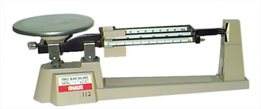
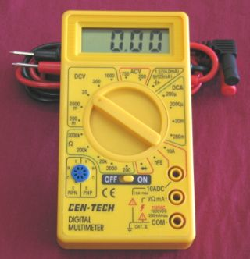
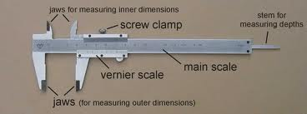
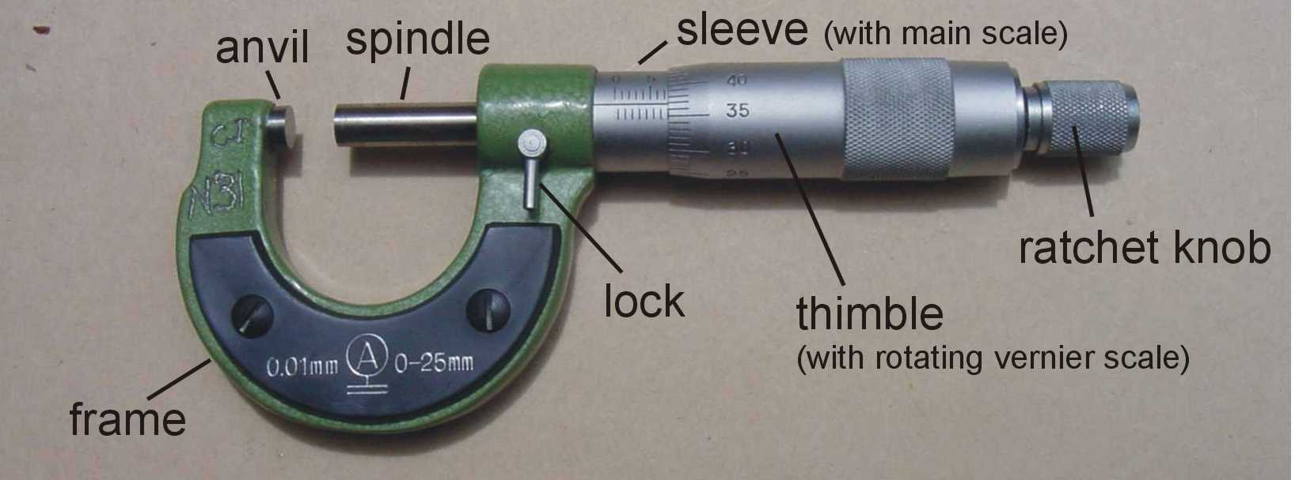
Chap 2
Measurement Techniques
Lim Wan Hong
July 2012

Slide 2
Learning outcomes
(d) show an understanding of the distinction between systematic errors (including zero errors) and random errors
(e) show an understanding of the distinction between precision and accuracy
(f) assess the uncertainty in a derived quantity by simple addition of actual, fractional or percentage uncertainties

Slide 3
What is meant by systematic errors and random errors?
Systematic errors | Random errors
Errors that result in all the readings taken being faulty in one direction, either all smaller or larger than the actual values These errors are constant errors that cause all results to be incorrect by roughly the same amount in the same direction | Errors that result in scattering of readings about a mean value The errors have equal chance of being +ve or –ve

Slide 4
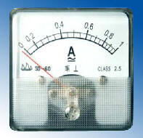
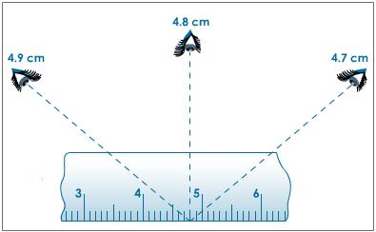
Examples / causes
Systematic errors | Random errors
Zero error: Ammeter with zero/initial reading of –0.2mA causes all the readings taken being 0.2mA larger the actual reading. | Parallax error: eye of observer is not on the same level as the mark on the ruler Inconsistent judgment of experimenter, e.g. uncertainty to judge if a falling object has reached the ground before stopping the stopwatch. What is the nearest scale mark? Fluctuation in the measured quantities

Slide 5
How to eliminate/reduce?
Systematic errors | Random errors
It is can be estimated and eliminated entirely and hence the accuracy of reading is increased. Cannot be reduced by taking repeated readings. By varying the instrumentation being used (check the readings with another scale or experimenter) | This error can only be reduced to increase the precision of readings but can not be eliminated totally. It is reduced by taking repeated readings at different points/angles/times and averaging them.

Slide 6
How to eliminate/reduce?
Systematic errors | Random errors
by using good & systematic experimental technique To reduce parallax error: Use a pointer and a mirror along the scale, e.g. ammeter, take the pointer reading when the pointer overlaps with its image on the mirror. | measure a set of data & draw a line of best fit. e.g. s= ½ g t² – plot s vs. t² gradient = ½ g. Use instrument of higher precision

Slide 7
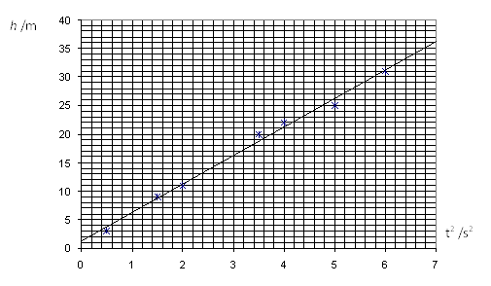
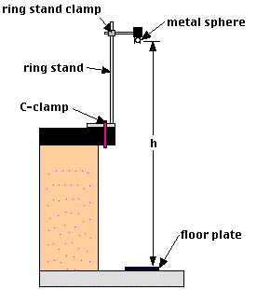
Example
The time t for a ball to fall from rest through a distance h is measured and the acceleration, g due to gravity is calculated by h = ½ g t ². Measurements of t for several different values of h are carried out and a graph of h vs. t ² is plotted as shown below.

Slide 8
Questions
Explain which features of the graph suggest that there is
systematic error
(ii) random error
The line of best fit does not pass through the origin
Data are scattered along the line of best fit

Slide 9
Accuracy vs. Precision
Accuracy - how close the readings taken to the actual (accepted) values. (How correct it is)
Precision - how close the readings taken among them. It indicates a degree of scattering. Large degree of precision does not necessarily imply accuracy. More decimal places, more precise.

Slide 10
Accuracy vs. Precision
Acceleration of free fall g is determined from few measurements as follows. Comments on these measurements.
(1) 4.88 ms⁻²; 4.91 ms⁻²; 4.95 ms⁻²; 4.85 ms⁻²; 4.90 ms⁻²
(2) 9.88 ms⁻²; 7.91 ms⁻²; 4.95 ms⁻²; 11.85 ms⁻²; 12.90 ms⁻²
(3) 9.88 ms⁻²; 9.81 ms⁻²; 9.79 ms⁻²; 9.87 ms⁻²; 9.89 ms⁻²
Precise but not accurate
Not Precise and not accurate
Precise and accurate

Slide 11
Uncertainty / error of measurement
Uncertainty of measured quantities => determined from instruments
Length – metre rule - ± 0.1 cm
Uncertainty of calculated quantities => determined from the equations
Area – length & width

Slide 12
Uncertainty
Absolute uncertainty (from instrument), e.g. Δd
Fractional uncertainty, e.g. Δd/d
Percentage of uncertainty, e.g. Δd/d × 100%
ONE S.F
Accepted up to two S.F

Slide 13

y = a ± b
Quantities a and b are measured.
uncertainty of y, that is Δy, is calculated by:
Example:
initial temperature b = (34.5 ± 0.1)º C
final temperature , a = (18.0 ± 0.1)º C
Determine the magnitude of change in temperature with its uncertainty ΔT.

Slide 14
Solution
initial temperature b = (34.5 ± 0.1)º C
final temperature , a = (18.0 ± 0.1)º C
Change in temperature T = |a – b| = 16.5
ΔT = Δa+ Δb = 0.1+0.1=0.2 (not 0.20)
Thus, T = (16.5± 0.2)º C
Consistent in decimal places
Uncertainty - One sig. fig.

Slide 15
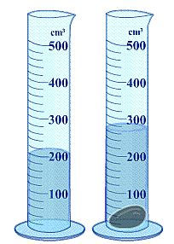
Try this !
Example: the volume of a sphere is determined by water displacement method.
initial volume b = (50.0 ± 0.5) cm ³
final volume, a = (72.5 ± 0.5) cm ³
Determine the volume of the sphere with its uncertainty ΔV.
Answer : (23 ± 1) cm ³
No decimal places
Uncertainty - One sig. fig.

Slide 16

y = ab or y = a/b
Quantities a and b are measured.
uncertainty of y, that is Δy, is calculated by:
Example: mass and volume of a sphere are measured as follows:
Mass m = (29.2 ± 0.1) g
volume, V = (23 ± 1) cm ³
Determine the density of the sphere its uncertainty Δρ.

Slide 17
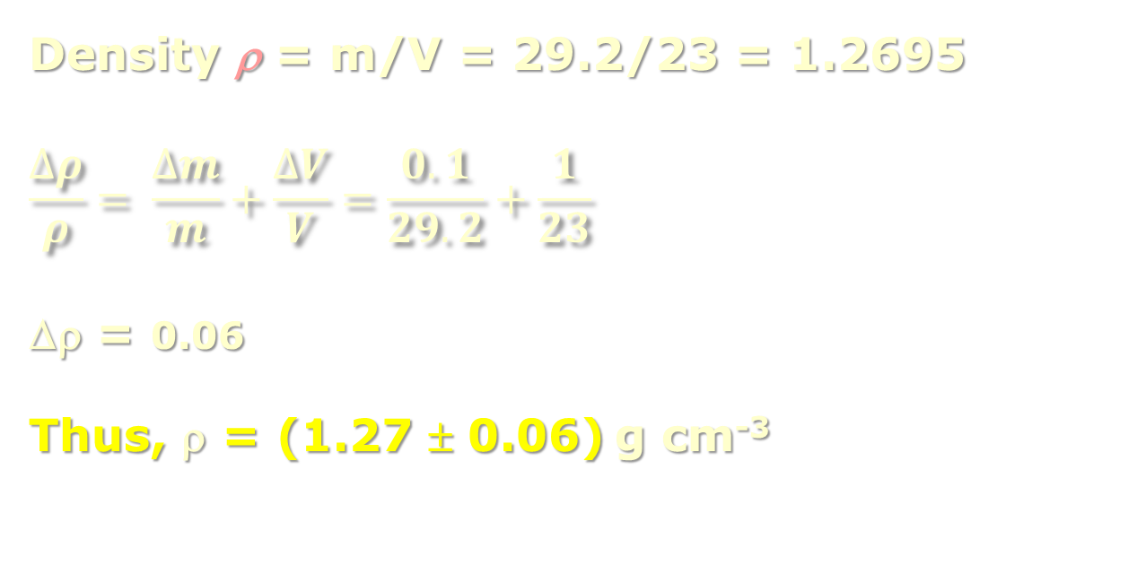
Solution
Mass m = (29.2 ± 0.1) g
volume, V = (23 ± 1) cm ³
Density ρ = m/V = 29.2/23 = 1.2695
$$\frac{∆ρ}{ρ}= \frac{∆m}{m}+\frac{∆V}{V}=\frac{0.1}{29.2}+\frac{1}{23}$$
Δρ = 0.06
Thus, ρ = (1.27 ± 0.06) g cm⁻³

Slide 18

y = k a ^{n} ; k & n are constants
Constant k is not measured and hence, it does not have an error.
If n =3, then y = k x a x a x a

Slide 19
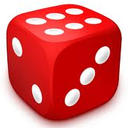
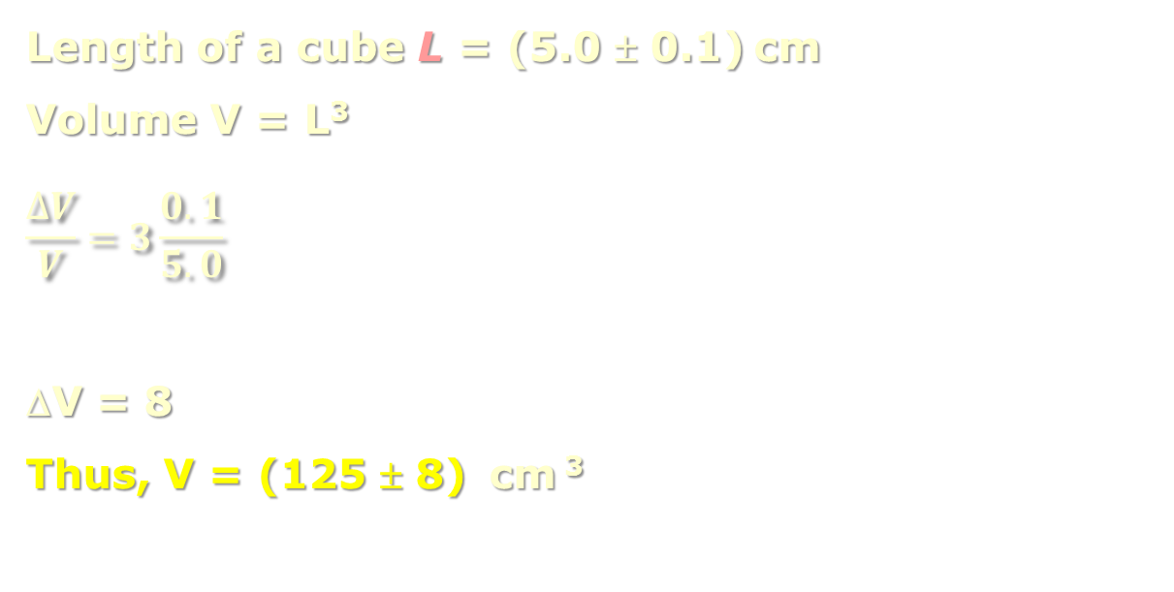
Example:
Length of a cube L = (5.0 ± 0.1) cm
Volume V = L³
$$\frac{∆V}{V}=3\frac{0.1}{5.0}$$
ΔV = 8
Thus, V = (125 ± 8) cm ³

Slide 20
Rounding off to the nearest tens or hundreds
(125 ± 10) -> (130 ± 10)
(12596 ± 100) -> (12600 ± 100)

Slide 21
Try this!
The length of a piece paper is measured as (297 ± 1) mm, its width (209 ± 1) mm.
Calculate:
i. fractional uncertainty in its length
ii. percentage of uncertainty in its length
iii. area with its uncertainty
Answer A = (62100 ± 500 ) mm ²

Slide 22

Any questions ?

Slide 23

The End

